Slide 1

An Embedded Platform for Automated Multiple Patient Monitoring System
Under the guidance of
Dr. Raja ratnam
By
Meghanath Nakka
Divya Jangili

Slide 2
AIM OF THE PROJECT
The project aims in designing a system which is capable of monitoring the heart rate and temperature of the person and also alerts in case of emergency through SMS to predefined numbers.
This project aims in sending alert messages in emergency times, i.e. when a person is alone in home or travelling and his heartbeat or body temperature rises or lowers then alerting messages will be send to the mobile phone, the message consist of location of that person also.

Slide 3
An Embedded Platform for Automated Multiple Patient Monitoring System
Regulated power supply
Heartbeat
Sensor
Amplifier
Micro
controller
RS 232
interfacing
GSM
modem
Temperature
sensor
ADC
Buzzer
driver
Buzzer
LCD
driver
LCD
Reset
Crystal Oscillator
LED indicators

Slide 4
The major building blocks of this project
Regulated power supply with voltage regulator.
Microcontroller
Crystal Oscillator
Reset button
LCD.
GSM modem
RS 232 interfacing circuit.
Heart beat sensor
Temperature sensor
Buzzer
LED indicators.

Slide 5
Regulated power supply
The major blocks of power supply are given below
Transformer
Rectifier
Filter
7805 voltage regulator

Slide 6
Transformer
Transformer is a electromagnetic device which induces the voltage due to magnetic field present between primary and secondary windings.
It has two windings called as primary winding and secondary winding. We are giving input 230v input voltage at primary side. The output of transformer is 9v(ac only).
In this project we are using 9v step down transformer

Slide 7
We have two types of transformers
Step up transformer.
Step down transformer.
Step up transformer:
This transformer will step up the voltage that is this transformer will increase the voltage.
Step down transformer:
This type of transformers will step down the voltage. That is this will convert high voltage in to low voltage.
Mostly for project purpose we are using only step down transformer.

Slide 8
Rectifier
Rectifier is circuit which converts the ac in to dc. We have two types of rectifier.
Full wave rectifier
Half wave rectifier
Full wave rectifier again classified as follows
Bridge rectifier
Cetertapped full wave rectifier
In this project we are using bridge rectifier because the efficiency of the bridge rectifier is high compare to all rectifiers.

Slide 9
Filter
The output of rectifier is not pure DC. It may contain some ripple components that is pulsating DC. To eliminate this ripple components which are present in output we are using filter.
Filter is a circuit which is used to eliminate the ripples present in rectified output.
We have many types of filters.
Most of the power supplies are using capacitor filter to filter out the ripples present in output.

Slide 10
Regulator
The output of filter is not constant output voltage it will varies according to changes in input but we want constant output voltage. For this purpose we are using voltage regulator.
Regulator is defined as it is a device which will maintain constant output irrespective of changes in input.
The most popular regulator series is 78xx series. This series have more advantages.
We are using 7805 voltage regulator to maintain constant 5v output voltage irrespective of changes in input voltage.

Slide 11
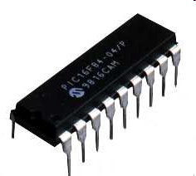
Microcontroller
A microcontroller is a small computer on a single integrated circuit consisting of a relatively simple CPU combined with support functions such as a crystal oscillator, timers, watchdog timer, serial and analog I/O etc.
Microcontrollers are also used in scientific, high technology, and aerospace projects.
Microcontrollers are designed for small or dedicated applications.

Slide 12
Some microcontrollers may operate at clock rate frequencies as low as 4 kHz, as this is adequate for many typical applications, enabling low power consumption (mill watts or microwatts)
Microcontrollers are used in automatically controlled products and devices, such as automobile engine control systems, remote controls, office machines, appliances, power tools, and toys. By reducing the size and cost compared to a design that uses a separate microprocessor, memory, and input/output devices, microcontrollers make it economical to digitally control even more devices and processes.
A microcontroller can be considered a self-contained system with a processor, memory and peripherals and can be used with an embedded system.

Slide 13
Microcontrollers must provide real time response to events in the embedded system they are controlling. When certain events occur, an interrupt system can signal the processor to suspend processing the current instruction sequence and to begin an interrupt service routine (ISR, or "interrupt handler").
Embedded processors are usually used to control devices, they sometimes need to accept input from the device they are controlling. This is the purpose of the analog to digital converter. Since processors are built to interpret and process digital data, i.e. 1s and 0s, they won't be able to do anything with the analog signals that may be being sent to it by a device.
So the analog to digital converter is used to convert the incoming data into a form that the processor can recognize. There is also a digital to analog converter that allows the processor to send data to the device it is controlling.

Slide 14
PIC is a family of Harvard architecture microcontrollers made by Microchip Technology, derived from the PIC1640 originally developed by General Instrument's Microelectronics Division. The name PIC initially referred to "Peripheral Interface Controller".
A PIC's instructions vary from about 35 instructions for the low-end PICs to over 80 instructions for the high-end PICs. The instruction set includes instructions to perform a variety of operations on registers directly, the accumulator and a literal constant or the accumulator and a register, as well as for conditional execution, and program branching.

Slide 15
PIC CONTROLLER
PIC microcontroller has four optional clock sources.
Low power crystal
Mid range crystal
High range crystal
RC oscillator (low cost).
Programmable timers and on-chip ADC.
Up to 12 independent interrupt sources.
Powerful output pin control (25 mA (max.) current sourcing capability per pin.)
EPROM/OTP/ROM/Flash memory option.
I/O port expansion capability.

Slide 16
Advantages of microcontroller
Low cost
User friendly
Easily available in market
We can reprogram it up to 1000 times
Less power consumption

Slide 17
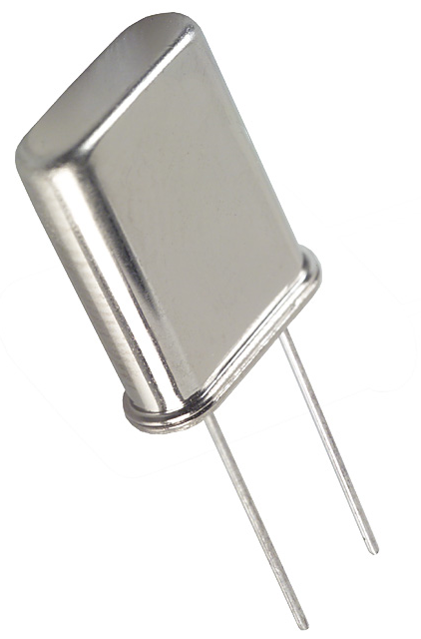
OSCILLATOR
An electronic oscillator is an electronic circuit
that produces a repetitive Electronic signal, often a sine wave or a square wave.
PIC micro controller internally having 4mhz clock frequency.
We are giving the 20Mhz clock frequency as an external source for increasing the system performance

Slide 18
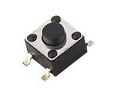
RESET BUTTON
Reset is used for putting the microcontroller into a 'known' condition. That practically means that microcontroller can behave rather inaccurately under certain undesirable conditions. In order to continue its proper functioning it has to be reset.
A switch placed between the digital input and ground will short the digital input to ground when it is pressed. This means the voltage seen at the input will be high when the switch is open and low when the switch is closed.

Slide 19
GSM
GSM, which stands for Global System for Mobile communications, reigns (important) as the world’s most widely used cell phone technology. Cell phones use a cell phone service carrier’s GSM network by searching for cell phone towers in the nearby area.
Need of GSM:
The GSM study group aimed to provide the followings through the GSM:
Improved spectrum efficiency.
International roaming.
Low-cost mobile sets and base stations (BS)
High-quality speech
Compatibility with Integrated Services Digital Network (ISDN) and other telephone company services.
Support for new services.

Slide 20
Global system for mobile communication (GSM) is a globally accepted standard for digital cellular communication.
GSM – Architecture:
A GSM network consists of several functional entities whose functions and interfaces are defined. The GSM network can be divided into following broad parts.
· The Mobile Station (MS)
· The Base Station Subsystem (BSS)
· The Network Switching Subsystem (NSS)
· The Operation Support Subsystem (OSS)

Slide 21
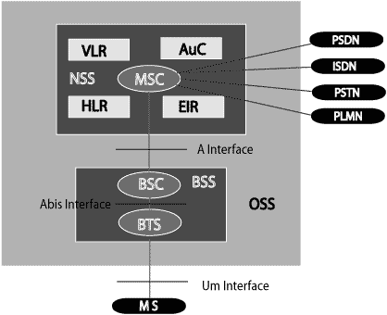
Following fig shows the simple architecture diagram of GSM Network.

Slide 22
The added components of the GSM architecture include the functions of the databases and messaging systems:
Home Location Register (HLR)
· Visitor Location Register (VLR)
· Equipment Identity Register (EIR)
· Authentication Center (AuC)
· SMS Serving Center (SMS SC)
· Gateway MSC (GMSC)
· Charge back Center (CBC)
· Transcoder and Adaptation Unit (TRAU)

Slide 23
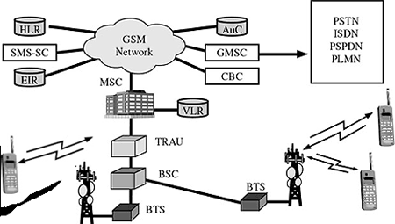
Following fig shows the diagram of GSM Network along with added elements.

Slide 24
GSM network areas:
In a GSM network, the following areas are defined:
Cell: Cell is the basic service area, one BTS covers one cell. Each cell is given a Cell Global Identity (CGI), a number that uniquely identifies the cell.
Location Area: A group of cells form a Location Area. This is the area that is paged when a subscriber gets an incoming call. Each Location Area is assigned a Location Area Identity (LAI). Each Location Area is served by one or more BSCs.
MSC/VLR Service Area: The area covered by one MSC is called the MSC/VLR service area.
PLMN: The area covered by one network operator is called PLMN. A PLMN can contain one or more MSCs.

Slide 25
Advantages of GSM:
1.GSM is already used worldwide with over 450 million subscribers.
2. International roaming permits subscribers to use one phone throughout Western Europe. CDMA will work in Asia, but not France, Germany, the U.K. and other popular European destinations.
3.GSM is mature, having started in the mid-80s. This maturity means a more stable network with robust features. CDMA is still building its network.
4.GSM's maturity means engineers cut their teeth on the technology, creating an unconscious preference.
5.The availability of Subscriber Identity Modules, which are smart cards that provide secure data encryption give GSM m-commerce advantages.

Slide 26
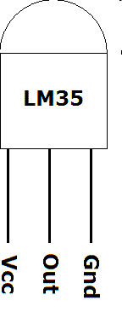
LM 35 (temperature sensor)
A sensor is a device that measures a physical
quantity and converts it into a signal which can
be read by an observer or by an instrument.
The output of the lm 35 temperature sensor is in milli volts (mv).
connect the Vcc Pin to 5v and GND to GND, output of the lm 35 temperature sensor is in the analog form, to convert this into digital form we are going to use analog to digital converter.

Slide 27
LM 35 CHARACTERISTICS
Calibrated in ° Celsius
0.5 ° c accuracy
Rated for full -50 ° c to +150 ° c
Operates from 4 to 30 v
Suitable for remote applications
Low self heating
Low power consumption

Slide 28
HEART BEAT SENSOR
Heart beat sensor is one type of sensor which monitor the heart beat pulses for every minute. It will check the heart beat pulses and the same data will be given to Microcontroller.
This heart beat sensor is designed to give digital output of heat beat when a finger is placed inside it.
This digital output can be connected to Microcontroller directly to measure the Beats Per Minute (BPM) rate. It works on the principle of light modulation by blood flow through finger at each pulse.

Slide 29
Working of heart beat sensor
The sensor consists of a super bright red LED and light detector. The LED needs to be super bright as the light must pass through finger and detected at other end.
when the heart pumps a pulse of blood through the blood vessels, the finger becomes slightly more opaque and so less light reached the detector.
With each heart pulse the detector signal varies. This variation is converted to electrical pulse.

Slide 30
This signal is amplified and triggered through an amplifier which outputs +5V logic level signal.
The output signal is also indicated on top by a LED which blinks on each heart beat.
The data will be given to Microcontroller for every minute. In this way the heartbeat sensor will monitor the heartbeat pulses of patient.

Slide 31
Features
Heat beat indication by LED
Instant output digital signal for directly
connecting to Microcontroller
Compact Size
Working Voltage +5V DC

Slide 32
Applications
Digital Heart Rate monitor.
Bio-Feedback control of robotics and applications.
Exercise machines.

Slide 33
LCD DISPLAY
LCD is used to display the messages.
LCD modules can be split into two groups: those that have built-in controller and driver chips, and those that have only driver chips. LCD displays that do not have controllers are typically used with powerful hardware, such as a laptop computer, where a video controller is available to generate the complex drive signals necessary to run the display. Most color and large (greater than 320x240) monochrome displays are of this type.
We are using 16/2 graphical LCD to display the messages. Most LCDs with 1 controller has 14 Pins and LCDs with 2 controller has 16 Pins (two pins are extra in both for back-light LED connections)

Slide 34
Advantages of LCDs:
• Download high quality fonts of any size, style or language easily and quickly
• Create graphics using primitives such as bitmaps, pixels, lines, rectangles and bar graphs.
Software Control:
• Backlight & Contrast is adjustable in most models
• 4 different brightness settings
• General Purpose Output (20mA drive)
• Line wrap and Auto screen scroll
• Bar Graphs and Large Digits
• Speed settings

Slide 35
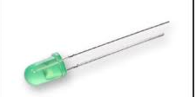
LED INDICATORS
LED’s are used as indicator lamps in
many devices, and are increasingly used
for lighting. Introduced as a practical electronic component
LED’s emitted low-intensity red light, but modern
versions are available across the visible, ultraviolet and
infrared wavelengths, with very high brightness.
Led indicators have a life of at least ten years and
consume 90 per cent less power than conventional indicators.
Depending on the type of the materials (Ga,As,p) led will
gives the output in different colors (red, Yellow, green etc..)

Slide 36
Future scope of this project
The project can be extended by adding blood pressure measuring; sugar levels of the person etc.
This project can also be extended by using GPRS and 3G technologies.
Through GPRS, we can monitor the house from anywhere in the world and 3G technologies can be used to view the person through video calling option.
This helps in finding out the person and fast responding to the situation. Accuracy of the GPS receiver can be extended by using DGPS (differential GPS ) technology

Slide 37
ADVANTAGES
Patient’s health status can be continuously monitored.
Incase of emergency intimation can be sent to predefined numbers.
Automatic heart rate and temperature monitoring and alerting.
Low power consumption.
Audible and visual alerts through LCD, buzzer
Efficient design.
Works anywhere in the world (GSM availability).
Highly efficient and user friendly design.
Easy to operate.
Low power consumption.

Slide 38
Disadvantages of this project
Proper installation required for proper operation of heart beat sensor.
Interfacing of Heartbeat sensor is sensitive.
The start up time of the system is more.
GSM modem depends on network signal strength.

Slide 39

QUERIES?

